Slide 1




Neurodevelopment, low level mercury exposure and genetic polymorphisms in birth cohorts from Slovenia and Croatia
Janja Snoj Tratnik^{1,7}, Ingrid Falnoga¹, Ajda Trdin^{1,7}, Anja Stajnko^{1,7}, Darja Mazej¹, Alenka Sešek Briški³, Joško Osredkar³, Mladen Krsnik³, Alfred B. Kobal², David Neubauer³, Jana Kodrič³, Staša Stropnik³, David Gosar³, Janja Marc⁴, Simona Jurković Mlakar⁴, Igor Prpić⁶, Zdravko Špirić⁵, Milena Horvat^{1,7}
¹Jožef Stefan’ Institute, Department of Environmental Sciences, Ljubljana, Slovenia
²Ex-Department of Occupational Health, Idrija Mercury Mine, Arkova 43, 5280 Idrija, Slovenia,
³University in Ljubljana, University Medical Centre Ljubljana, Slovenia,
⁴University in Ljubljana, Faculty of Pharmacy, Slovenia
⁵OIKON, Institute of Applied Ecology, Zagreb Croatia
⁶ University of Rijeka, Medical Faculty of Rijeka, Department of Paediatrics Croatia
⁷ ‘Jožef Stefan’ International Postgraduate School, Ljubljana, Slovenia
CROME Life+, Final Meeting, Athens, 20.12.2016

Slide 2
Diplomatic Conference
Minamata Convention, October 2013, Japan
"With the signing of the Minamata Convention on Mercury we will be going a long way in protecting the world forever from the devastating health consequences from mercury,”
says WHO Director-General Dr Margaret Chan.
"Mercury is one of the top ten chemicals of major public health concern and is a substance which disperses into and remains in ecosystems for generations, causing severe ill health and intellectual impairment to exposed populations."

Slide 3

127 countries signed the convention in 2013
38 countries ratified
_____________
50 countries needed for the convention to come into force

Slide 4
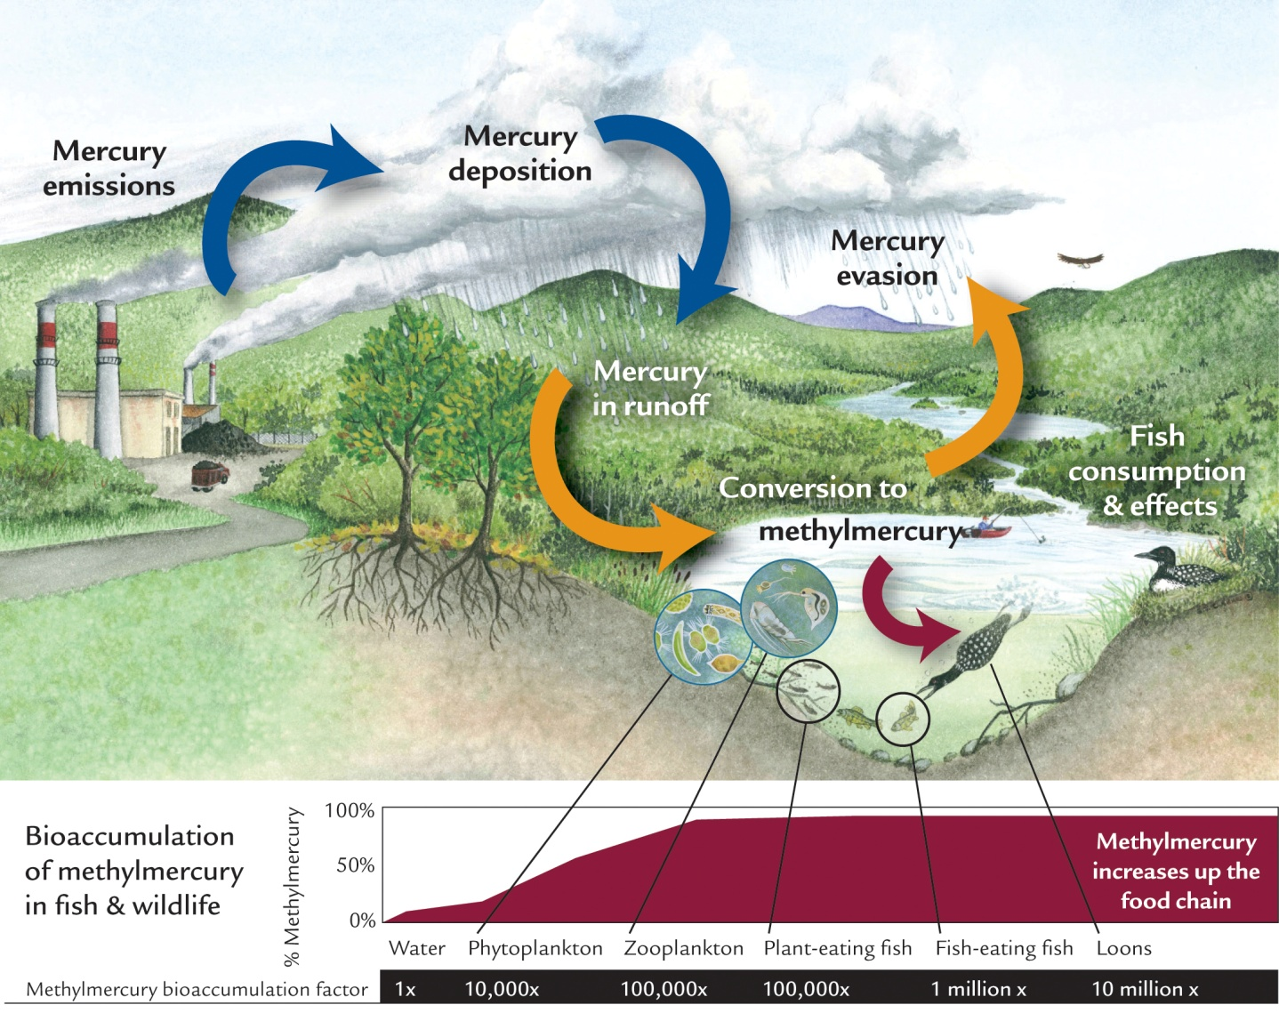
Courtesy of Evers, 2013

Slide 5
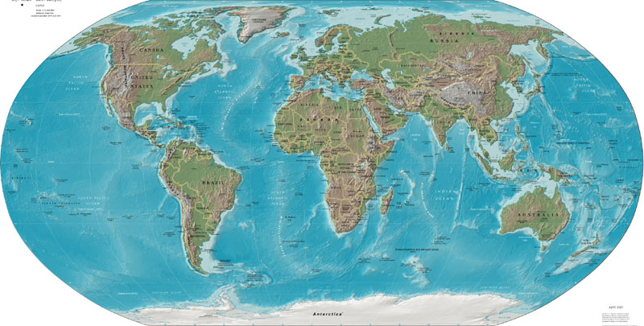
MeHg in humans: a worldwide concern
It is generally accepted that the formation and bioaccumulation of MeHg is the most critical point of environmental quality in mercury pollution.
The reduction of MeHg in food can therefore be defined as the priority objective with regard to the mercury contamination problem.
Elevated MeHg in many fish-eating populations throughout the world
Notably among coastal, island, river and lakeside populations and those living near reservoirs
Also: persons who eat large quantities of commercially sold high-end predators
MeHg exposure knows no geographic or social boundaries

Slide 6
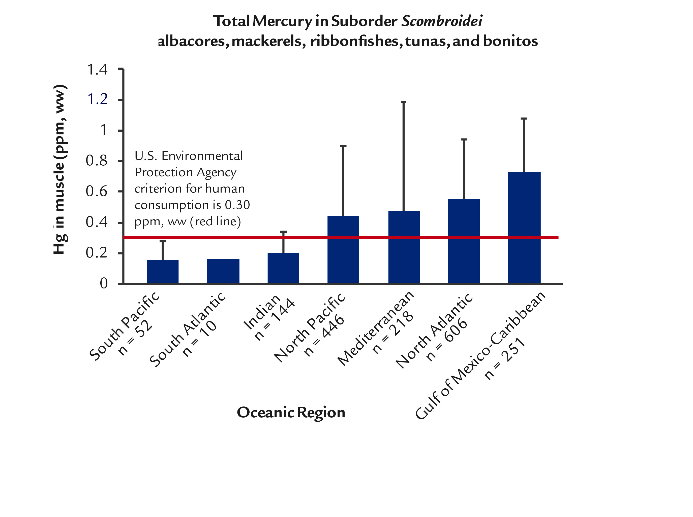
Global spatial pattern of Hg in fish
Fish Hg is expected to increase at current Hg loading rates
  North Pacific tuna will double by 2050 (if MeHg production mimics Hg deposition)
There will generally be a lag time in lowering fish Hg loads, especially in the open ocean
  More rapid positive responses in freshwater ecosystems
Sources:Evers, pers. comm. BRI unpubl. data, Sunderland et al. 2009, Karimi et al. 2012, Mason et al. 2012

Slide 7
Hg levels in biomarkers
(2000-2013)
50 studies
12.000 individuals included
Miklavčič et al, 2013

Slide 8
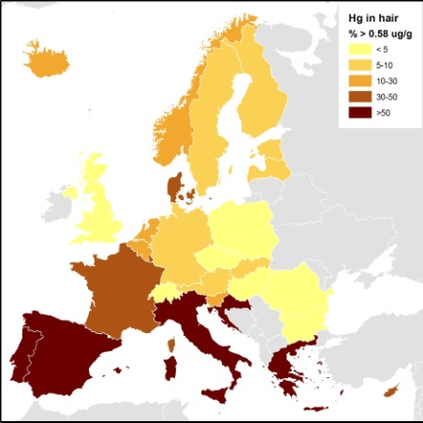
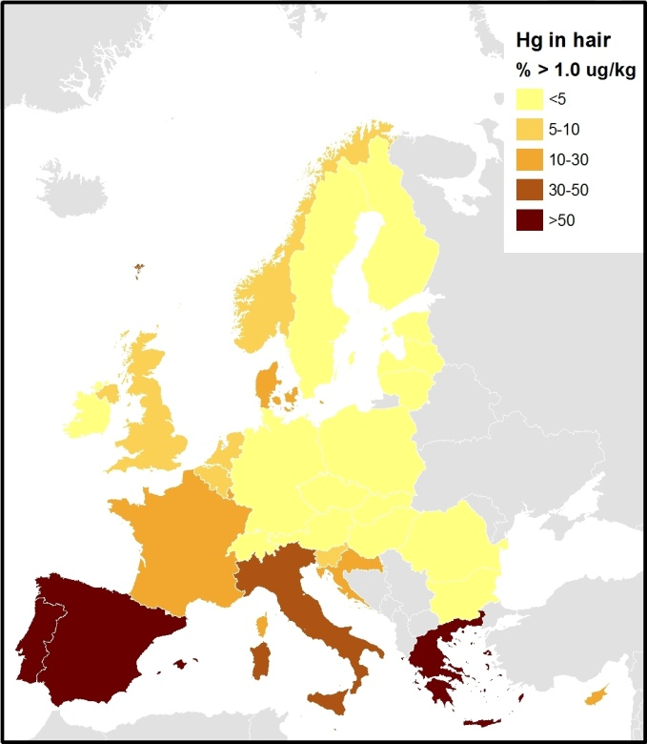
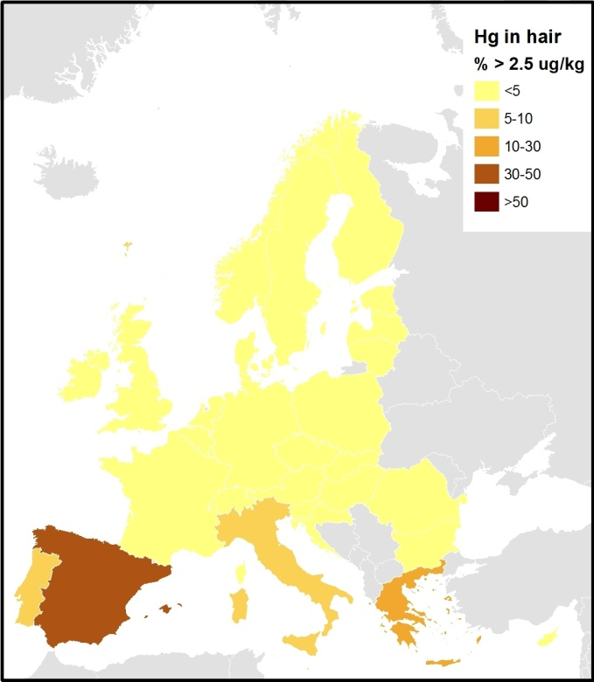
THg in hair in EU populations (Miklavčič et al. 2014)
Percent of population exceeding 0.58 µg/g, 1.0 µg/g and 2.5 µg/g THg levels in hair

Slide 9
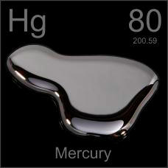
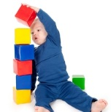
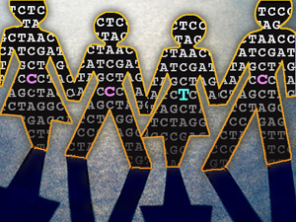
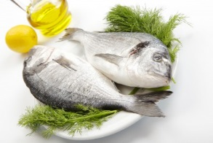
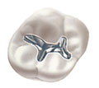
The Mediterranean study
Longitudinal cohort study of prenatal exposure to mercury (Hg) in the Mediterranean region
Overall aim: to assess association between exposure to low-to-moderate levels of Hg and neurodevelopment of prenatally exposed children
Specific aim: gene-environment interaction; to investigate gene polymorphisms that could modulate the association between Hg and neurodevelopment

Slide 10
Background
Epidemiological studies have demonstrated that the developmental neurotoxicity is associated with prenatal methyl mercury (MeHg) exposure (Grandjean and Landrigan 2006)
Effects of prenatal exposure to MeHg from fish consumption have been evaluated in many studies…
findings have been inconsistent, particularly when assessing the effects of exposures to low mercury levels
Susceptibility to mercury may be modified by genetic factors!

Slide 11
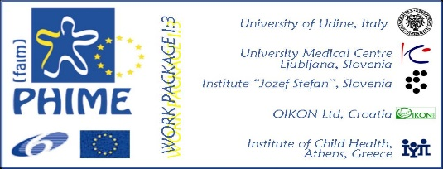
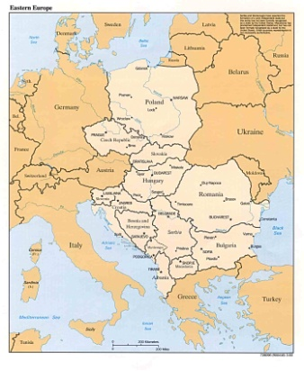
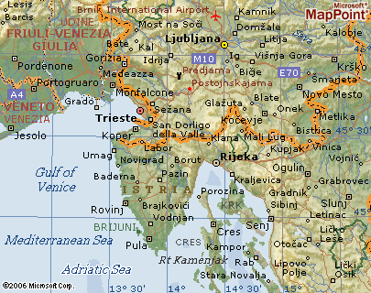
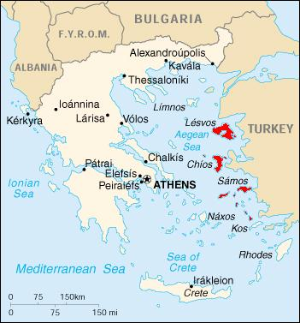
Mediterranean study areas
2006 - 2011
Notes:
CROME je odlična priložnost za follow up od PHIME študije

Slide 12
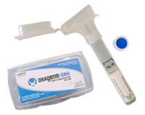
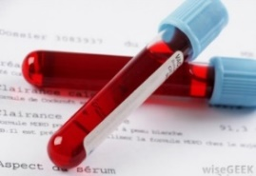
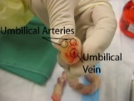
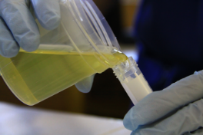
Study design
Delivery
Questionnaire: DETAILED
Sampling: MILK
MOTHER
Questionnaire: life-style, nutrition
Sampling: MATERNAL BLOOD, URINE, HAIR, SALIVA
Months
0
3
6
9
Pregnancy
Sampling:
HAIR
BLOOD
URINE
Child
0
18
6-8 years
Months
Clinical examination
Sampling:
CORD BLOOD
BAYLEY test
WISC IV
CHILD
Sampling:
HAIR
BLOOD
URINE
SALIVA
Metal exposure
Gene polymorpisms (SNPs)
Neurodevelopment
Cognitive score
Metals, POPs,
SNPs (targeted +GWAS), epigenetics, metabolomics,

Slide 13
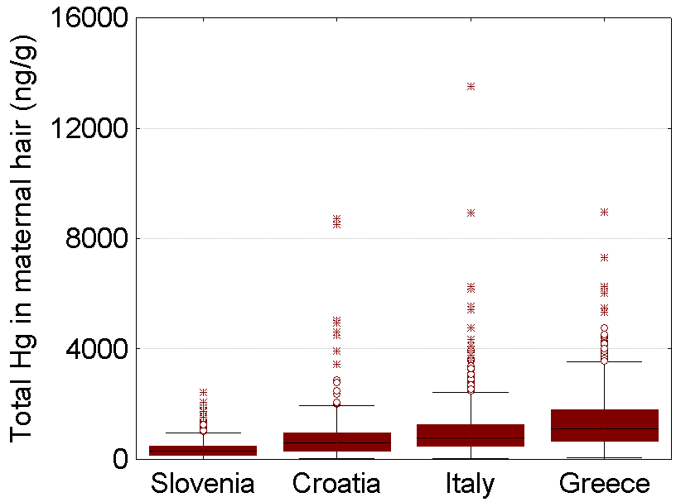
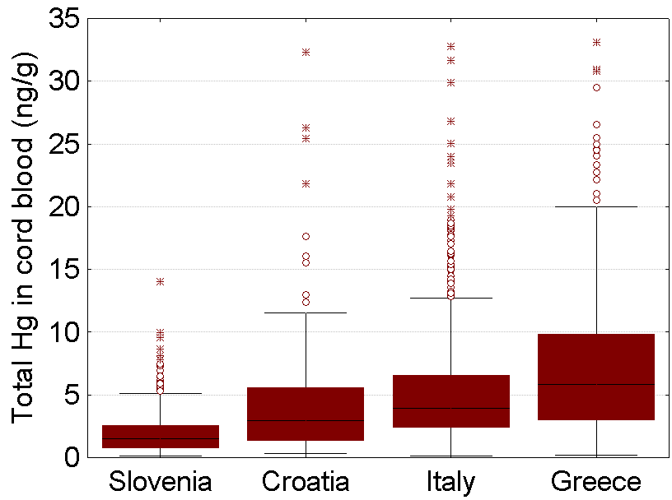
Hg in maternal hair and cord blood
Valent et al. 2011, 12, 13, Miklvačič et al., 2014

Slide 14
Results: Mercury exposure in the study population
Fish consumption freq
No. amalgams
Exposure characterized mainly by FISH CONSUMPTION
Less than once per month
2-3 times per month
At least once per week
Up to 5
6-9
10 or more
Cord blood Hg levels vs. frequency of fish consumption during pregnancy:
r_{s}=0.45, p<0.001
Cord blood Hg levels vs. number of dental amalgam fillings in mothers:
r_{s}=-0.08, p=0.224

Slide 15


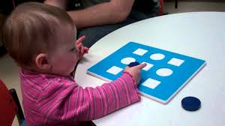
Neurodevelopment assessment
Bayley Scales of Infant and Toddler Development, Third Edition (Bayley-III)
  Cognitive
  Language
  Motor
  18 moths of age
Bayley-III score | All | SLOVENIA | CROATIA | p-value | no. children with delayed performance
 | mean ± SD | mean ± SD | mean ± SD
Cognitive | 111.7 ± 13.6 60-145 | 114.3 ± 13.6 70-145 | 106.7 ± 13.2 60-145 | <0.001 | 6
Language | 106.0 ± 14.4 50-144 | 105.3 ± 13.4 56-141 | 107.5 ± 16.0 50-144 | 0.130 | 20
Motor | 107.4 ± 10.3 58-142 | 106.9 ± 9.5 61-136 | 108.0 ± 11.5 58-142 | 0.355 | 5

Slide 16
Association between Hg, fish consumption and COGNITIVE / LANGUAGE domain
 | Cognition
 | beta | p
Hg in hair (ln) | 0.0614 | 0.9034
Fish consumption | 0.5645 | 0.0701
Model R² (N) | 0.21 (N=689)
Hg in cord blood (ln) | -0.2524 | 0.6472
Fish consumption | 0.9312 | 0.0084
Model R² (N) | 0.23 (N=571)
 | Language
 | beta | p
Hg in hair (ln) | 1.1992 | 0.0255
Fish consumption | 0.7752 | 0.0189
Model R² (N) | 0.23 (N=689)
Hg in cord blood (ln) | 0.3264 | 0.5809
Fish consumption | 1.0489 | 0.0056
Model R² (N) | 0.24 (N=571)
Adjusted for country, mother’s age at delivery, pre-pregnancy BMI, weight gain, cigarettes smoked, alcohol intake, dental visits, dental work, marital status of mother, home area, home ownership, number of children in family, parental education, sex of child, birth weight, daycare attendance at 18 months, child’s intake of fresh and homogenized fish at 18 months, breastfeeding, its length, and exclusiveness up to 4 months.

Slide 17
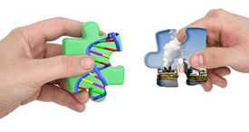
Gene x environment interaction
Prenatal exposure to metals
Genes involved in absorption-distribution-metabolism-elimination:
glutathione-related, selenoproteins (SEPP1), metallothioneins (MT1, MT2a, MT3, MT4),
arsenite (AsIII) methyltransferase , ABC transporters (ABCC1, ABCC2 and related ABCB)
Genes involved in pharmacokinetics of mercury and other metals
OR
Neuropsychological
performance
Genes involved in neuropsychological performance: PON1, BDNF, PGR, TF

Slide 18
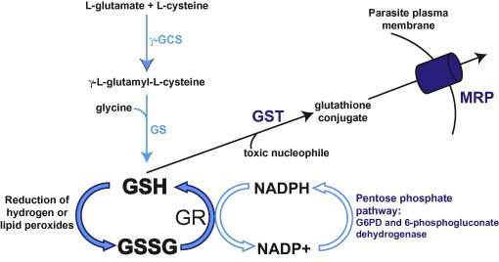
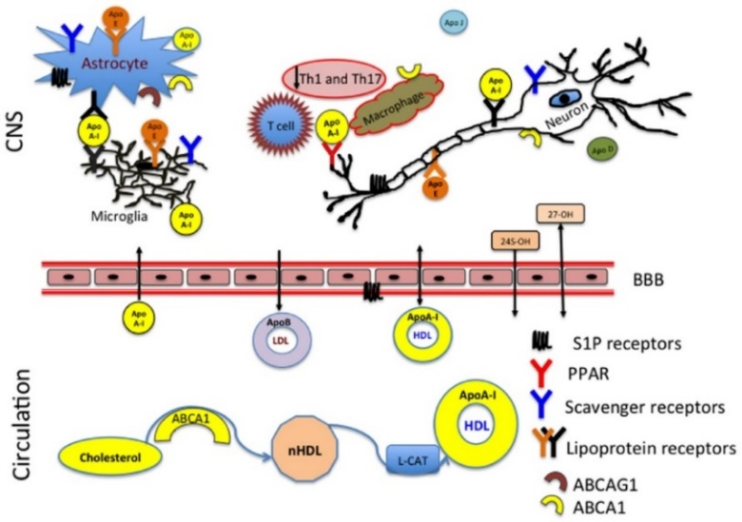
Gene polymorphisms
Apolipoprotein E (APOE)
Glutathione S-transferase (GST) genes
major lipid-transporting protein APOE expressed in the brain (astrocytes)
Apoe alleles: epsilon 2 (ε2), epsilon 3 (ε3) and epsilon 4 (ε4)
role of APOE genetic variants apparent in neurodevelopment (metabolism of cholesterol - major role in neurite outgrowth and synaptogenesis)
Potential role of APOE in Hg metabolism:
ε4 isoform - two arginines
ε3 isoform - one cysteine and one arginine
ε2 isoform - two cysteines
Glutathione (GSH): conjugation to electrophilic compounds (MeHg⁺, Hg²⁺)
GST: catalyzes the conjugation of GSH to electrophilic compounds
GSTT1 deletion and GSTM1 deletion → lack of enzyme activity
Ref: Gardner and Levin, Front. Pharmacol., 20 November 2015
Cysteine contains one thiol (–SH) group which can conjugate with Hg and help remove it from essential cellular binding sites

Slide 19
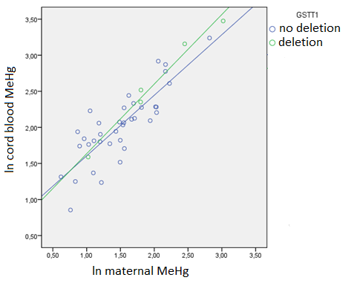
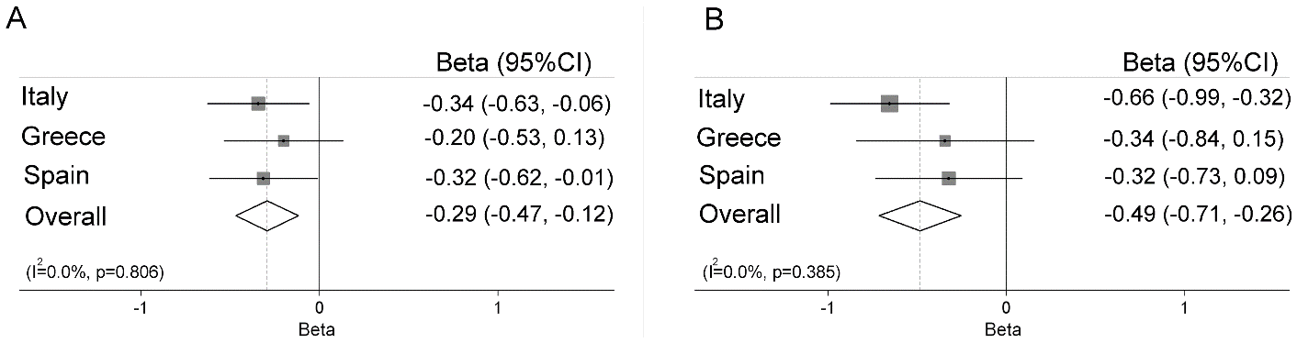
GSTT1 (cord blood vs maternal blood MeHg, ng/g)
Results: genotyping
Apolipoproteine, ApoE
GM=2.06
N=172
GM=2.57
N=36
GM=1.70
N=459
GM=2.12
N=107
ABC Transporter Genes (Llop et al 2013, PLOS)
Hg from fish consumption in carriers of different gene variants:
ABCB1 rs2032582: (A) GT vs. GG (B) TT vs. GT carriers
Notes:
Pregnant women without GSTT1 gene (GSTT1 deletion) showed significantly higher MeHg (but not total Hg) in cord blood compared to women with the presence of GSTT1 gene.
OR:
Deletion of GSST1 gene influenced cord blood methyl Hg in compare to maternal blood methyl Hg (higher cord blood to maternal blood ratio). In other words, GSTT1 seems to be responsible for transfer of methyl Hg from maternal to cord blood.

Slide 20
Statistical analysis – linear regression
Multivariate linear regression:
  prenatal exposure to Hg (Hg in maternal hair in cord blood)
  Neurodevelopment (Bayley-III score for the three domains)
  stratified by Apoe genotype
Covariates:
  Pregnancy history: mother’s age at delivery - BMI before pregnancy - weight gain increase - cigarettes smoked throughout the pregnancy - weekly alcohol intake - dental visits and new/replaced dental fillings
  SES: home area (<50, 50-100, >100 m²) - home ownership - parental education (the higher of the two) - number of children in the family - marital status of the mother at delivery
  Child: sex – birth weight - breastfeeding history (any vs none, duration and exclusiveness up to 4 months) - daycare attendance at 18 months - duration of the intake of fresh and homogenized fish up to 18 months
  Other metal(loid)s

Slide 21
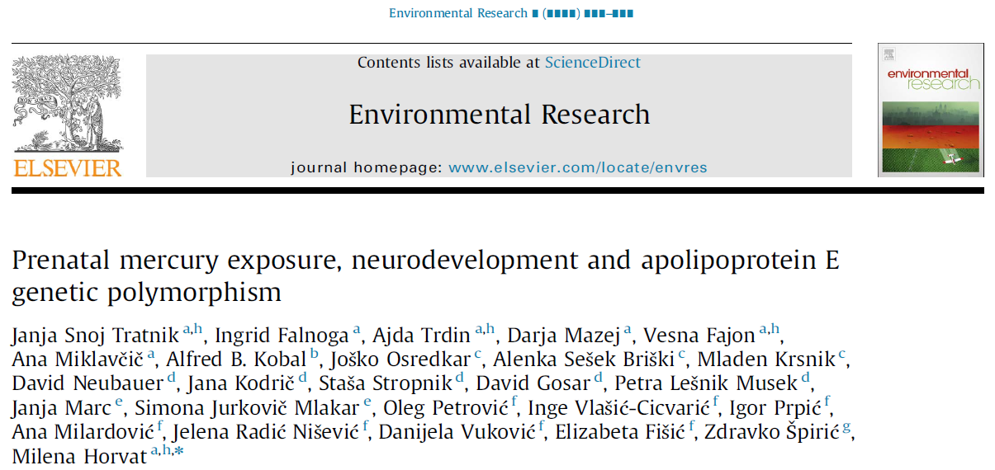
Results: cord blood Hg and Bayley score, stratified by the Apoe genotype
 |  | Coeff. (CI 95%), p-value, Bayley vs. total Hg in cord blood (ln)
Subjects | n | Cognitive | Language | Motor | Fine motor | Gross motor
All | 283 | -1.41 (-3.47, 0.66), 0.181 | -1.03 (-3.46, 1.40), 0.406 | -1.16 (-2.76, 0.44), 0.153 | -0.33 (-0.66, -0.01), 0.043 | -0.10 (-0.41, 0.22), 0.553
ε2, ε3 carriers | 232 | -0.49 (-2.76, 1.78), 0.949 | -0.59 (-3.42, 2.45), 0.682 | -0.84 (-2.68, 1.00), 0.369 | -0.29 (-0.66, 0.08), 0.122 | -0.06 (-0.41, 0.29), 0.742
ε4 carriers | 51 | -5.44 (-10.7, 0.19), 0.043 | -2.61 (-7.41, 2.20), 0.276 | -2.54 (-5.94, 0.86), 0.139 | -0.51 (-1.16, 0.13), 0.117 | -0.26 (-1.09, 0.57), 0.528
Interaction p* Apoe x Hg | 283 | 0.052 | 0.181 | 0.275 | 0.353 | 0.418
The model is adjusted for country, educational level of parents, child sex, maternal age, maternal smoking, BMI and Se and Pb levels in cord blood; *p-value for interaction term (Apoe*Hg) in the models with all subjects.
Other associations observed:
negative association: CB-Pb and motor score in ε4 non-carriers: -3.2 (CI 95%: -6.1, -0.23), p=0.035
positive association: CB-Se (serum) and language in All: 7.6 (CI 95%: -1.3, 16.6), p=0.094
Higher language scores in girls, All: 7.6 (CI 95%: 3.45, 10.6), p<0.001

Slide 22
Study design
Delivery
Questionnaire: DETAILED
Sampling: MILK
MOTHER
Questionnaire: life-style, nutrition
Sampling: MATERNAL BLOOD, URINE, HAIR, SALIVA
Months
0
3
6
9
Pregnancy
Sampling:
HAIR
BLOOD
URINE
Child
0
18
6-8 years
Months
Clinical examination
Sampling:
CORD BLOOD
BAYLEY test
WISC IV
CHILD
Sampling:
HAIR
BLOOD
URINE
SALIVA
Metal exposure
SNPs
Neurodevelopment
Cognitive score
Metals, POPs,
SNPs (targeted +GWAS), epigenetics, metabolomics,
n=284 (SLO)
n=164 (CRO)
n=180 (SLO)
n=in progress (CRO)

Slide 23

Conclusions and future work
Moderate but significant beneficial effect of fish consumption in pregnancy was observed for cognitive and language development!
Such effect may be due to PUFAs contained in fish.
Identification of gene variants that are responsible for individual‘s is important for risk assessment/prevention
even low-to-median prenatal Hg exposure in children with normal neurodevelopmental outcome may be associated with lower cognitive and fine motor scores at 18 months of age
Mercury speciation in biological samples, to determine what was the extent of inorganic Hg exposure
Re-evaluation of the obtained results using Weschler Intelligence assessment (WISC IV) at 6-8 years of age with consideration of other (epi)genetic changes, and deficiency of essential elements that can influence the observed associations

Slide 24

Thank you!
ACKNOWLEDGEMENTS
All participating mothers and their children
Financial support: EU 6. FP PHIME and Slovenian Research Agency (ARRS programe P-0143), CROME-LIFE+

Slide 25
Chrome Life+
- Fish advisory for the Mediterranean
https://www.epa.gov/choose-fish-and-shellfish-wisely/fish-and-shellfish-advisories-and-safe-eating-guidelines
http://oehha.ca.gov/fish/advisories

Slide 27
Why mercury?
Biogeochemical cycling of mercury (Hg)
Main exposure pathways
Hgº
Hg²⁺
Locally grown food on contaminated sites
Dental amalgams
CH₃Hg⁺
Fish consumption
Courtesy of Evers, 2013

Slide 28
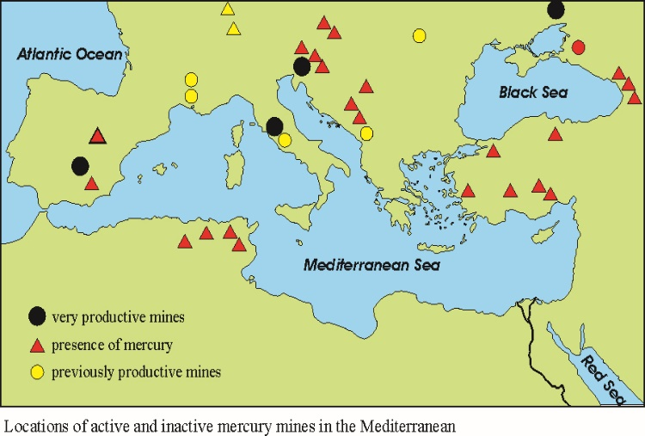
Mercury in the Mediterranean:
The distribution of mercury mineral belts and most productive Hg mines
Drivers for mercury study in the Mediterranean
Mercury in fish in the Mediterranean is among the highest in the world oceans
Renzoni, A.; Zino, F.; Franchi E. Mercury levels along the food chain and risk for exposed populations. Environ. Res. 77, 68–72 (1997).
Notes:
Predlagam, da se nekaj pove o tem kaj nas je vodilo do tega, da smo se šli cross medietrransko študijo

Slide 29
Work in progress…
Arsenite (AsIII) methyltransferase (AS3MT)
enzyme: role in As metabolism (AsIII → MMA→DMA)
(sub)isoforms of metallothioneins (MT)
proteins: thiol group (-SH) binding of trace elements,
role in metal metabolism, antioxidative cell protection, homeostasis
of Zn and Cu
(sub)isoforms : MT-1 (a, b, e, f, g, x), MT-2a, MT3 and MT4
Selenoprotein P (SEPP1)
proteine: antioxidative role
Paraoxonase1 (PON1), progesteron receptor (PGR), transferrin (TF) and brain-derived neurotrophic factor (BDNF)
Genome-Wide Association Study (GWAS)!

